Slide 1
Decentralized Vehicle Booking Service
Team Guide:
Mr. Ch. Mukesh,
Assistant Professor,
Department of CSE
Team members:
Pallevada Hema (178W1A05A1)
Kanuri Gayathri Phani Kumar (178W1A0583)
Posina Sravani (188W5A0520)
Paruchuri Satyendra (178W1A05A2)

Slide 2
Abstract
Online vehicle booking service became a growing need now-a-days as it offers an efficient and cheaper alternative. One can directly call a taxi to any location at any time they want without the need for a lengthy delay. There are various platforms implementing online vehicle booking service but the major issue with them is having a centralized authority which are pocketing huge profits. A fixed percentage of money paid by the user is taken by the centralized authority. These centralized systems also tend to misuse their user’s data and are also prone to several attacks. One of the best solutions to this problem is to use BlockChain. Our objective is to avoid this centralized authority by creating a decentralized application. Not just removing the central authority, BlockChain also provides several features like immutability, better transparency, enhanced security and traceability. Platforms like Ethereum and Hyperledger allows one to develop decentralized applications and deploy in the blockchain. Smart Contracts can be developed using Solidity to achieve decentralization. This maintains transparency, immutability and removes a central authority which may misuse its user's information.
Keywords: Decentralization, Ethereum, HyperLedger, Smart Contracts

Slide 3
Problem Statement
To develop a Decentralized Vehicle Booking Service application which removes the centralized authority and provides a transparent, secure and immutable platform to book vehicle services.

Slide 4
Project Title Justification
We are proposing a system which works on top of block chain by removing the centralized authority. It provides Online vehicle booking service to its users and hence we choose the title “Decentralized vehicle booking service”.

Slide 5
Solution Identified
A decentralized application can be developed using Solidity for developing smart contracts, HTML and CSS for developing front-end and Vanilla JavaScript for integrating front-end with smart contracts.

Slide 6
Objectives
Build a decentralized vehicle booking service which removes centralized authority.
Develop a model which can ensure transparency, immutability and traceability.
Ensure trust by using IPFS to store vehicle driver’s identity (license) .

Slide 7
Scope
Our proposed system can be used by normal people as well as vehicle drivers. Normal people can book vehicle service and vehicle drivers can accept the drops booked. Money transfer can be directly done between customers and drivers either as cash or crypto currency.

Slide 8
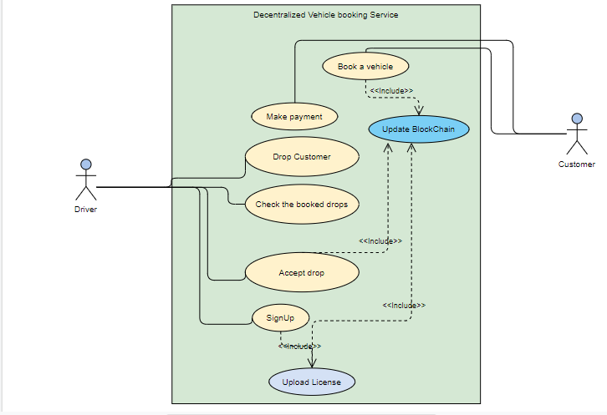
Use Case Diagram

Slide 9
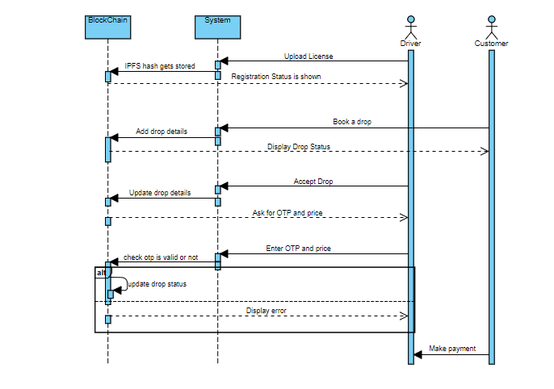
Sequence Diagram

Slide 10
Literature Review
Paper 1: Decentralized Applications: The Blockchain-Empowered Software System
This paper was written by WEI CAI,, ZEHUA WANG, JASON B, ZHEN HONG, CHEN FENG AND VICTOR C. M. LEUNG 2. This paper was published in IEEE Access, 2018.
Summary:
This paper presents the development of blockchain systems to highlight the importance of decentralized applications and the future value of blockchain.
In this paper, all the key elements of the blockchain systems were clearly discussed and it provides the information regarding the evolution of decentralized ledgers which led to classic blockchain systems.
This paper provides the details about the things that we should consider when selecting a blockchain implementation.
Recent developments in blockchain systems were summarized clearly.

Slide 11
Advantages:
Detailed Explanation on blockchain, decentralized applications, smart contracts, software systems.
History and future of blockchain and decentralized applications were discussed clearly.
This paper has presented application scenario of decentralization applications.
Disadvantages:
Payment channels are not much supportive for decentralized applications in future.
Link:
https://ieeexplore.ieee.org/document/8466786

Slide 12
Paper 2: Toward a Secure and Decentralized Blockchain-based Ride-Hailing Platform for Autonomous Vehicles
This paper was written by Ryan Shivers , Mohammad Ashiqur Rahman , and Hossain Shahriar.
Summary:
This paper presents a structure for developing a decentralized ride-hailing application.
Hyperledger fabric blockchain was used as a platform to implement the ride-hailing application.
Ride-hailing services help to fill the vacant seats in vehicle with the persons who are travelling to same place as the driver.
In this paper, autonomous vehicles are used in this ride-hailing application as they collect all the information from sensors such as cameras, lasers and electromagnetic field detectors.
This paper also provides a detailed information about blockchain, Hyperledger fabric and information security
This paper clearly explains the chain code protocols and transactions security with their architecture.
This paper describes good evaluation methods such as chain code analysis, constant rate network traffic, poison
distribution based network traffic and Organization Restructuring Traffic.

Slide 13
Advantages:
Privacy protection for both riders and drivers.
It performs well even under large network load.
Disadvantages:
Latency is high in delayed transactions.
No peer to peer public key infrastructure
Link:
https://arxiv.org/pdf/1910.00715.pdf

Slide 14
Paper 3: Blockchain for the Internet of Vehicles: A Decentralized IoT Solution for Vehicles Communication Using Ethereum
This paper was written by Rateb Jabbar , Mohamed Kharbeche , Khalifa Al-Khalifa , Moez Krichen and Kamel Barkaoui . This paper was published in MPDI, 2020.
Summary:
IOV which stands for Internet of Vehicles, is one of the applications of IOT.
This IOV shows an interaction between vehicles and their infrastrcuture. But IOV have certain limitations like lack of privacy, centralization etc.
In this paper we can see how blockchain can address the problems caused by IOV .
Blockchain technology has a ability to improve the transport systems by making them secure and autonomous.
In this way, the resources of transport systems such as crowd sourcing technology can be used more effectively.
Recent developments in blockchain systems were summarized clearly.

Slide 15
Advantages:
Detailed Explanation on blockchain and its applications.
Blockchain is an efficient and secure mechanism for IoV communications.
Disadvantages:
Since IoT being incorporated, there is always a chance of security breach at hardware side.
Link:
https://www.mdpi.com/1424-8220/20/14/3928

Slide 16
Paper 4: EtherRent: A Co-operative Car Rental Platform:
This paper was written by Akhilesh Nair, Nelson Chacko, Rihab Kasim, Ani Sunny. This paper was published in
IRJET , 2020
Summary:
This paper gives a detailed information about the how the decentralized online car rental service works.
We know that, these days many people are taking cars on rents.
By using blockchain technology we can create a open platform , so that there will a clear picture for customer and cab owner before raid starts.
If a customer wants to have a car for rent, he can choose a car from all the available cars by looking at the features of the cars.
After the usage of vehicle by customer, the owner can get the condition of car from the sensors incorporated.
The smart contract written will take care of payment and penalty between customer and car owner.

Slide 17
Advantages:
As there is no involvement of third party entire profit goes to users.
All actions are easily traceable since blockchain is being used here.
Disadvantages:
Sensory data can be vulnerable since it can be modified easily either at their location or during transit.
Link:
https://www.irjet.net/archives/V7/i4/IRJET-V7I4343.pdf

Slide 18
Paper 5: Blockchain in Healthcare
This paper was written by Sourav Kumar, Utkarsh Kumar, Nalin Sanjay Singh and Mohamed Fathimal.
Summary:
This paper gives a detailed explanation on working of Blockchain in healthcare.
It is mainly concerned on healthcare in handling the sharing of medical data electronically and medical records to patients, doctors and other staffs members.
On entering the platform the user has to decide whether he/she wants to register as doctor or patient or staff by entering their name and selecting their role.
Medical records to be verified by the doctor the patient first needs to provide permission to the doctor.
Doctor can get patient records from their access list. After analyzing the health records of patient doctor can prescribe necessary medication and adds current medical report to the network.
Patient can get their medical reports and can revoke permission at any time.

Slide 19
Advantages:
As there is no involvement of third party entire profit goes to users.
All actions are easily traceable since blockchain is being used here.
Disadvantages:
Sensory data can be vulnerable since it can be modified easily either at their location or during transit.
Link:
https://www.academia.edu/download/64598634/IRJET-V7I5701.pdf

Slide 20
Data Collection
The user’s identity is uploaded into block chain using IPFS. The uploaded identity can be retrieved using hash of the uploaded document through infura.

Slide 21
Software Requirements
Visual Studio Code
Remix IDE
Meta Mask

Slide 22
Methodology
The Water fall model is the most suitable development methodology to implement to this project. As all the requirements are known at the beginning of the project, water fall model is most flexible to implement this project. Below is the flow of water fall model.

Slide 23
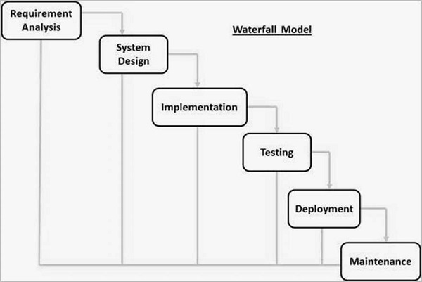
Model
Requirement analysis
System design
Implementation
Testing
Development
Maintenance
Waterfall Model

Slide 24
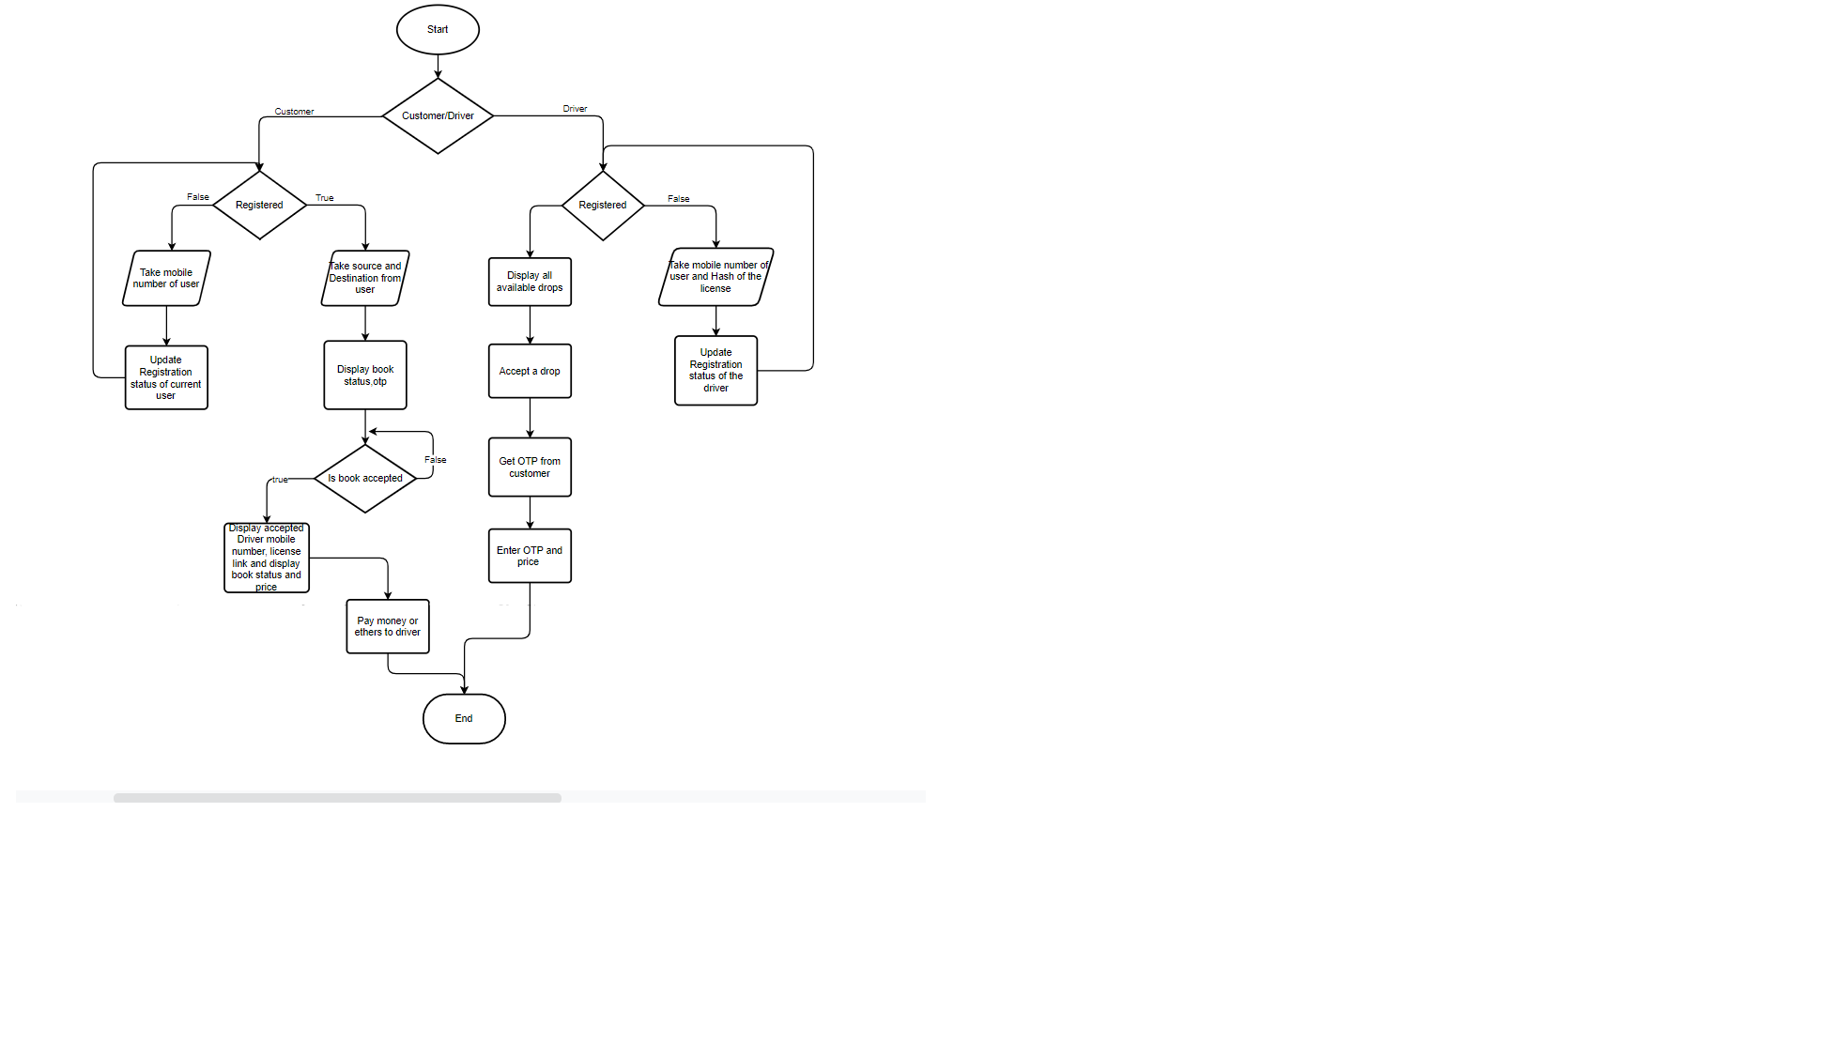
Proposed System

Slide 25
Coding
Coding involves 3 phases:
Creation of smart contract
Creation and styling of front end
Integrating front end with smart contract

Slide 26
Smart Contract
Smart contract is created using Solidity language in Remix IDE .
Creation of Structures to hold blockchain data:
struct person{
address add;
uint64 mobile;
bool reg;
uint8 lid;
mapping(uint8=>bool) allids;
}
mapping(address=>person) allpersons;

Slide 27
Smart Contract (contd…)
Creation of function:
function signup_as_user(uint64 mob, address cust_add)public{
allpersons[msg.sender].add=cust_add;
allpersons[msg.sender].reg=true;
allpersons[msg.sender].mobile=mob;
}
Creation of OTP:
keccak256(abi.encodePacked(now,msg.sender,lastid))

Slide 28
Front end
Creation of Front end is done using HTML. This project involves creation of HTML pages:
Driver Sign Up
Driver Home Page
Customer Sign Up
Customer Home Page
Status Page
Styling of HTML pages is done using CSS. Styling is done using <style> tag.

Slide 29
Integration
Integration of front end with smart contract can be done using Java Script.
Creation of async functions:
async function LoadContract(){
await loadWeb3();
window.contract = await loadContract();
}
Calling smart contract functions:
await window.contract.methods.signup_as_user(mob,account).send({ from: account })
await window.contract.methods.is_reg_veh(acc).call()

Slide 30
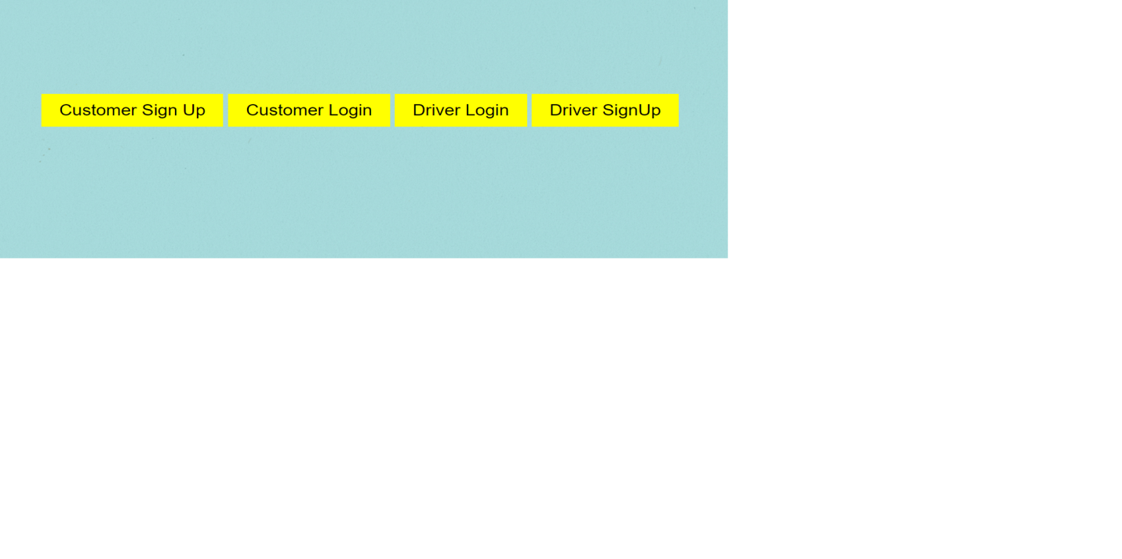
Implementation
Home Page

Slide 31


Customer SignUp page
Driver SignUp page

Slide 32


License Uploading Page
Customer Home Page

Slide 33

Status Page

Slide 34

Driver Home Page

Slide 35

Status Page

Slide 36

Drop taking Page

Slide 37

Final Status Page

Slide 38
Conclusion
Through this project, we are aiming to overcome the major pitfalls of online vehicle booking services being in the hands of centralized authorities. Our decentralized platform avoids a third party getting profits from our transactions. Trustlessness, the major issue of decentralized platforms has overcame by uploading driver’s documents to block chain and allowing users to view the documents using theirs hash value. Traceability, one of the important features of decentralized applications will help us keep track of all the actions done in the network.

Slide 39
References
[1] Wang S, Ding W, Li J Yuan, Ouyang L, Wang F, “Decentralized autonomous organizations: concept, model, and applications”, IEEE Transactions on Computational Social Systems 6(5), pp. 870–878,2019.
[2] Roberto Tonelli, Andrea Pinna, Gavina Baralla, Simona Ibba, “Ethereum smart contracts as blockchain-oriented microservices”, IEEE 19th International Conference on Agile Software Development Companion, pp. 10-1145, 2018
[3] Hofmann, F. Wurster, S. Ron, Bohmecke-Schwafert, “The immutability concept of blockchains and beneﬁts of early standardization”, IEEE ITU Kaleidoscope Challenges for a Data-Driven Society (ITU K), pp.1-8, 2017.
[4] Simone Porru, Andrea Pinna, Michele Marchesi, and Roberto Tonelli, “Blockchain-oriented software engineering: challenges and new directions”, IEEE 39th International Conference on Software Engineering Companion, pp. 169-171, 2017.

Slide 40
References (contd…)
[5] Katiuscia Mannaro, Andrea Pinna, and Michele Marchesi, “Crypto-trading: Blockchain-oriented energy market”, IEEE AEIT International Annual Conference, pp. 1-5, 2017.
[6] Davide Taibi, Valentina Lenarduzzi, and Claus Pahl, “Processes, Motivations, and Issues for Migrating to Microservices Architectures: An Empirical Investigation”, IEEE Cloud Computing 4, pp. 22-32, 2017.
[7] Christidis K, Devetsikiotis M, “Blockchains and Smart Contracts for the Internet of Things”, IEEE Access 4, pp. 2292–2303, 2016.

Slide 41
Thank you

